Slide 1
Introduction to Coding using Python
8-Hour, 1-Day course

Slide 2
Contents
Future of Work: What is Programming
Python as a Learning Language
Demonstrate use cases and/or companies that use Python for different domains
Basic Programming Knowledge
Explain the use of Variables
Explain Functions
Explain Control Flow
Explain Libraries/Packages
Describe Programming Best Practices and its Importance
Demonstrate some Best Practices
Practices

Slide 3
What is Programming
What is the aim of programming?
Pragmatically, the result of programming is a program.
Program
An unambiguous series of steps
An unambiguous series of processes or procedures
An unambiguous series of instructions
“A computer program is a collection of instructions that performs a specific task when executed by a computer.”

Slide 4
What is Programming
Common misunderstanding: Coding vs Programming
Programming is the formal act of writing code, and the term also encompasses the greater nuances of computer science.
Programming requires the big picture, or the overall view of how different pieces of the software work together.
Coding is the act of “creating code” but did not necessarily have the knowledge or grace of the traditionalists.
Coding is “less intimidating” than programming, and usually lacks the big picture.
This is an ongoing debate of terms.

Slide 5
What is Programming
Skills of a coder/programmer
Analytical mindset, also known as computational thinking (to be elaborated later)
Communication skills
Technical skills

Slide 6
What is Programming
Computational thinking can be broadly defined as (Grover, Shuchi; Pea, Roy (2013). "Computational Thinking in K–12 A Review of the State of the Field". Educational Researcher. 42):
Using abstractions and pattern recognition to represent the problem in new and different ways
Logically organizing and analyzing data
Breaking the problem down into smaller parts
Approaching the problem using programmatic thinking techniques such as iteration, symbolic representation, and logical operations
Reformulating the problem into a series of ordered steps (algorithmic thinking)
Identifying, analyzing, and implementing possible solutions with the goal of achieving the most efficient and effective combination of steps and resources
Generalizing this problem-solving process to a wide variety of problem

Slide 7
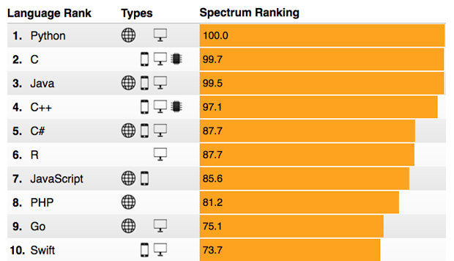
Python Programming Language
IEEE Spectrum ranks Python as top programming language in 2017 (https://spectrum.ieee.org/computing/software/the-2017-top-programming-languages)

Slide 8
Features of Python Programming Language
Beginner Friendliness
Python was designed to be easy to understand and fun to use.
Easy to Understand
Python reads like English, which takes a lot of syntax-learning stress off coding beginners.
Saturday Kids (https://www.saturdaykids.com) uses Python to introduce programming to kids as young as 10 years old.
Books like Python for Kids (https://www.nostarch.com/pythonforkids)
“Force” You to Write Readable Codes

Slide 9
Who Uses Python Programming Language
https://wiki.python.org/moin/OrganizationsUsingPython
Google: Many components of the Google spider and search engine are written in Python.
Battlefield 2: Uses Python to implement core elements of the gameplay such as score keeping and team balancing.
Civilization 4: Has all its inner logic, including AI, implemented in Python.
Success Stories: https://www.python.org/about/success/
University of St Andrews, Scotland: Uses Python to implement student management and class scheduling systems.
Journyx TimesheetTM (used by Parsons Brinckerhoff) is implemented in Python.

Slide 10
Basic Programming Knowledge: Variables
A variable is a storage location paired with an associated symbolic name
Eg., x = 10
Eg., length = 15
Programming variables have some correspondence to mathematical variables
The extent of correspondence depends on programming language

Slide 11
Basic Programming Knowledge: Variables
Try and see which of these are acceptable:
>>> numberA = 20
>>> Anumber = 22
>>> .numberA = 24
>>> 1number = 26
>>> _.numberA = 28
>>> _1number = 30
>>> number2big = 32
>>> number_A = 34
>>> number B = 36

Slide 12
Basic Programming Knowledge: Variables
Programming variables have a data type
For example, integer, float (decimal numbers), character, string, etc
Usually a variable has a fixed data type (unable to change data type during execution)
Usually a result of hardware limitation – different registers can hold different types of data
But sometimes, fixing of data type is too strict
Some programming languages allows change of data types using typecasting operations
Some programming languages release this constraint completely – allowing data type change

Slide 13
Basic Programming Knowledge: Variables
>>> numberA + numberA
40
>>> number2big / numberA
1.6
>>> number2big // numberA
1
>>> number2big % numberA
12
>>> str(numberA) + str(numberA)
'2020'
>>> str(numberA) + numberA

Slide 14
Basic Programming Knowledge: Variables
>>> stringA = 'Maurice'
>>> stringB = "Maurice"
>>> stringA + stringB
'MauriceMaurice'
>>> stringA + ' ' + \ stringB
'Maurice Maurice'
>>> int(stringA)
>>> stringC = '10'
>>> stringC + stringC
'1010'
>>> int(stringC)
10
>>> int(stringC) + int(stringC)
20

Slide 15
Basic Programming Knowledge: Variables
Variables are items
Very often, it can be useful to have
A series (like a vector) of numbers (same data types) under a variable name
A series of variables of different data types bundled together (like a record)
Forms data structures
Common data structures
List or one dimensional array
Two dimensional array
Map or dictionary (also known as a record)

Slide 16
Basic Programming Knowledge: Data Structures
List or one dimensional array
For example, a = ['a', 'b', 'c', 'd', 'e', 'f',
'g', 'h', 'i', 'j']
Two dimensional array
For example, b = [['a', 'b', 'c'],
['d', 'e', 'f'],
['g', 'h', 'i', 'j']]

Slide 17
Basic Programming Knowledge: Variables
>>> a = ['a', 'b', 'c', 'd', 'e', 'f', 'g', 'h', 'i', 'j']
>>> len(a)
10
>>> a[1]
'b'
>>> a[-1]
'j'
>>> a[-5]
>>> a[10]

Slide 18
Basic Programming Knowledge: Variables
>>> b = [['a', 'b', 'c'], ['d', 'e', 'f'], ['g', 'h', 'i', 'j']]
>>> b[0]
['a', 'b', 'c']
>>> b[0][1]
'b’
>>> b[0][1] = 200
>>> b
[['a', 200, 'c'], ['d', 'e', 'f'], ['g', 'h', 'i', 'j']]
>>> a[5] = 5
>>> a
['a', 'b', 'c', 'd', 'e', 5, 'g', 'h', 'i', 'j']
>>>

Slide 19
Basic Programming Knowledge: Variables
>>> a
['a', 'b', 'c', 'd', 'e', 5, 'g', 'h', 'i', 'j’]
>>> a[0:-1]
['a', 'b', 'c', 'd', 'e', 5, 'g', 'h', 'i’]
>>> a[:-1]
['a', 'b', 'c', 'd', 'e', 5, 'g', 'h', 'i’]
>>> a[2:-2]
['c', 'd', 'e', 5, 'g', 'h']

Slide 20
Basic Programming Knowledge: Data Structures
Map or dictionary (also known as a record)
For example, employee = {‘firstname’: ‘Peter’,
‘lastname’: ‘Jackson’,
‘empID’: 23010,
‘department’: ‘procurement’,
‘appraiser’: 10550}

Slide 21
Basic Programming Knowledge: Variables
>>> employee = {'firstname': 'Peter’, 'lastname': 'Jackson’,
'empID': 23010, 'department': 'procurement',
'appraiser': 10550}
>>> employee['appraiser']
10550
>>> employee['appraiser'] = 10700
>>> employee
{'firstname': 'Peter', 'lastname': 'Jackson', 'empID': 23010, 'department': 'procurement', 'appraiser': 10700}
>>> employee['awards'] = ['BestEmployee2016']
>>> employee
{'firstname': 'Peter', 'lastname': 'Jackson', 'empID': 23010, 'department': 'procurement', 'appraiser': 10700, 'awards': ['BestEmployee2016']}
>>> employee['awards'].append('BestEmployee2017')
>>> employee
{'firstname': 'Peter', 'lastname': 'Jackson', 'empID': 23010, 'department': 'procurement', 'appraiser': 10700, 'awards': ['BestEmployee2016', 'BestEmployee2017']}

Slide 22
Tea Break

Slide 23
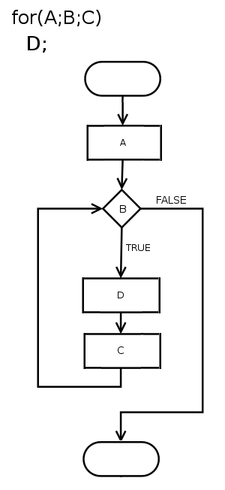
Basic Programming Knowledge: Control Flow
Without control flow, there is no decision making in a software.
Everything is sequential (top to bottom) without control flow.
Control flow controls the order of execution.
Simplifies and “shortens” the program.
https://upload.wikimedia.org/wikipedia/commons/0/06/For-loop-diagram.png

Slide 24
Basic Programming Knowledge: For Loop
for loop iterates over items of any collection (list/tuple/set/etc) or string
As we will be handling long sequences/strings/collections, we will be using for loop often.
for item in collection/string: do some action with item
for item in collection/string: do action 1 with item
else:
do action 2 if action 1 cannot be executed with item

Slide 25
Basic Programming Knowledge: For Loop
>>> a
['a', 'b', 'c', 'd', 'e', 5, 'g', 'h', 'i', 'j’]
>>> for item in a:
print(item + item)
aa
bb
cc
dd
ee
10
gg
hh
ii
jj

Slide 26
Basic Programming Knowledge: For Loop
>>> a
['a', 'b', 'c', 'd', 'e', 5, 'g', 'h', 'i', 'j’]
>>> for item in a:
item = 'TellyTubby' + str(item)
print(item)
TellyTubbya
TellyTubbyb
TellyTubbyc
TellyTubbyd
TellyTubbye
TellyTubby5
TellyTubbyg
TellyTubbyh
TellyTubbyi
TellyTubbyj

Slide 27
Basic Programming Knowledge: For Loop
>>> multiple9 = [9, 18, 27, 36, 45, 54, 63, 72, 81, 90, 99, 108]
How can I use for loop and append to generate this list?

Slide 28
Basic Programming Knowledge: For Loop
>>> multiple9 = [9, 18, 27, 36, 45, 54, 63, 72, 81, 90, 99, 108]
How can I use for loop and append to generate this list?
>>> multiple9 = []
>>> for i in range(1, 13, 1):
multiple9.append(9*i)
>>> multiple9
[9, 18, 27, 36, 45, 54, 63, 72, 81, 90, 99, 108]

Slide 29
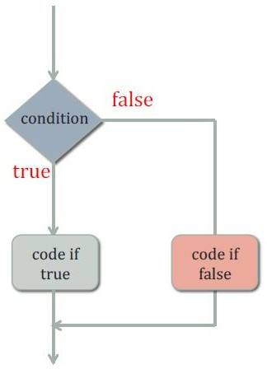
Basic Programming Knowledge: If
If else/elif is a conditional statement as shown in the below flowchart:
if condition:
block of code to execute if condition is true
else:
another block of code to execute if condition is false
>>> dna = ’atgtgga’
>>> if ’a’ in dna:
print ("’a’ is in dna")
’a’ is in dna
>>> if ’c’ in dna:
print ("’c’ is in dna")
# if condition not satisfied, and else command is # not specify, it will do nothing

Slide 30
Basic Programming Knowledge: If Statement
>>> for i in multiple9:
if i % 2 == 0:
print('%s is an even number' % str(i))
else:
print('%s is a odd number' % str(i))
9 is a odd number
18 is an even number
27 is a odd number
36 is an even number
45 is a odd number
54 is an even number
63 is a odd number
72 is an even number
81 is a odd number
90 is an even number
99 is a odd number
108 is an even number

Slide 31
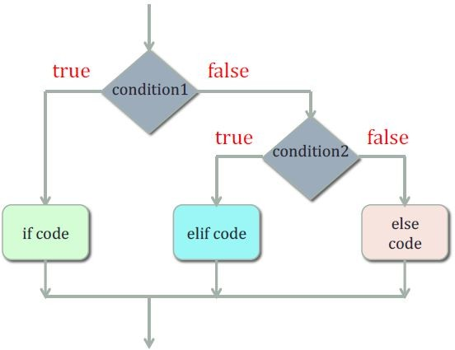
Basic Programming Knowledge: If
To test for several conditions in one, we can use elif (short form for else if).
Use this (nested if) to check for multiples of 9 for odd/even numbers and multiples of 5

Slide 32
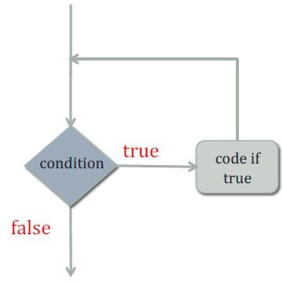
Basic Programming Knowledge: While Loop
While loop is a block of statements executed as long as some condition is true.
while condition:
block of code to execute while condition is true
while condition:
block of code to execute while condition is true
else:
another block of code to execute once the condition is false

Slide 33
Basic Programming Knowledge: While Loop
>>> listA = list(range(10))
>>> listA
[0, 1, 2, 3, 4, 5, 6, 7, 8, 9]
>>> index = 0
>>> while index < len(listA):
print(listA[index])
index = index + 1
0
1
2
3
4
5
6
7
8
9

Slide 34
Basic Programming Knowledge: While Loop
>>> a
['a', 'b', 'c', 'd', 'e', 5, 'g', 'h', 'i', 'j’]
>>> for item in a:
item = 'TellyTubby' + str(item)
print(item)
TellyTubbya
TellyTubbyb
TellyTubbyc
TellyTubbyd
TellyTubbye
TellyTubby5
TellyTubbyg
TellyTubbyh
TellyTubbyi
TellyTubbyj
Re-do this into a while loop

Slide 35
Lunch Break

Slide 36
Basic Programming Knowledge: Functions
Function:
Takes in one/multiple input(s), performs computations with those values and produces an output as required by the user.
Input(s)
General syntax:
Function
def function_name(input argument(s)):
"""description of the function if needed"""
blocks of codes to be executed
return output
Output(s)

Slide 37
Basic Programming Knowledge: Functions
Given this, do you know what it does?
area_circle(radius):
area = π * radius * radius
return area
Area1 = area_circle(7)

Slide 38
Basic Programming Knowledge: Functions
area_circle(radius):
area = π * radius * radius
return area
Area1 = area_circle(7)
In Python,
def area_circle(radius):
area = math.pi * radius * radius
return area
Area1 = area_circle(7)

Slide 39
Basic Programming Knowledge: Functions
Write a function, power, to raise each element in a list to a specified exponent.
>>> def power(datalist, exponent=1):
<implement this section>
return datalist
>>> multiple9
[9, 18, 27, 36, 45, 54, 63, 72, 81, 90, 99, 108]
>>> power(multiple9, 1)
[9, 18, 27, 36, 45, 54, 63, 72, 81, 90, 99, 108]
>>> power(multiple9, 2)
[81, 324, 729, 1296, 2025, 2916, 3969, 5184, 6561, 8100, 9801, 11664]

Slide 40
Basic Programming Knowledge: Functions
Reusable:
Reuse the code for different inputs of the same kind instead of rewriting it.
Call the function as many times as possible in your program.
Abstractable:
Abstract functions written by others as part of the sub-steps in your program (sometimes we do not necessarily need to know how it is done).
Just needs to know what is done.

Slide 41
Basic Programming Knowledge: Libraries
Functions form the vocabulary of a language.
Every programming language / platform needs to have a common set of “standard” functions.
Where are the “standard” functions?
In “standard” library
The extensiveness of standard library is a selling point.
You can ensure that everyone has a copy – like inbuilt into the language.
In Python, we call it Python Standard Library
https://docs.python.org/3/library/index.html

Slide 42
Basic Programming Knowledge: Best Practices
Set of informal rules that the software development community has learned over time which can help improve the quality of software.
The fundamental reasons for best practices
Readability: Can you read your own code after 6 months or a year without a coffee?
Maintainability: Can someone read your code and understand what on earth you are doing?
Extensibility: Can you add a feature (eg, cater to a new input) easily?

Slide 43
Basic Programming Knowledge: Best Practices
print('Welcome to this calculator!')
print('It can add, subtract, multiply and divide whole numbers from 0 to 50')
num1 = int(raw_input('Please choose your first number: '))
sign = raw_input('What do you want to do? +, -, /, or *: ')
num2 = int(raw_input('Please choose your second number: '))
if sign == '+’: result = float(num1) + float(num2)
if sign == '-’: result = float(num1) - float(num2)
if sign == '*’: result = float(num1) * float(num2)
if sign == '/’: result = float(num1) / float(num2)
print('%s %s %s = %s' % (str(num1), sign, str(num2), str(result)))
Can you read this code and see what it does?
Compare with https://github.com/sobolevn/python-code-disasters/blob/master/python/my_first_calculator.py

Slide 44
Basic Programming Knowledge: Best Practices
Basic best practices
Use meaningful variable / function names
Use descriptive names but not too long
def area_circle(radius):
area = math.pi * radius * radius
return area
Area1 = area_circle(7)
versus
def A(r):
return math.pi * r * r
aa = A(7)

Slide 45
Basic Programming Knowledge: Best Practices
Keep each function “short” and readable
Each function should only do one operation
If a function does more than one operation, it can be divided into 2 functions
Keep the length of each function into a printable page (30 lines or shorter)
Reduce the levels of nesting (if possible)
Keep the width of a line to 80 characters (70 characters will be better)

Slide 46
def runReport(population):
popFitness = {}
for k in list(population.keys()):
popFitness[k] = population[k].fitnessScore
averageFitness = [population[k].fitnessScore
for k in list(population.keys())]
bestFitness = max(averageFitness)
averageFitness = sum(averageFitness) /\
float(len(averageFitness))
print('Generation %s, Best Fitness: %.7f' % \
(generations, bestFitness))
def run(population, max_generations):
generations = 0
while (generations < max_generations):
for i in range(len(population)):
population[i].runnerFunction()
population[i].dataFunction()
population[i].comparatorFunction()
runReport(population)
if True in [population[i].fitted
for i in range(len(population))]:
return (generation, population)
_mutate()
_mate()
generations = generations + 1
return (generation, population)
def run(population, max_generations):
generations = 0
while (generations < max_generations):
for i in range(len(population)):
population[i].runnerFunction()
population[i].dataFunction()
population[i].comparatorFunction()
popFitness = {}
for k in list(population.keys()):
popFitness[k] = population[k].fitnessScore
averageFitness = [population[k].fitnessScore
for k in list(population.keys())]
bestFitness = max(averageFitness)
averageFitness = sum(averageFitness) /\
float(len(averageFitness))
print('Generation %s, Best Fitness: %.7f' % \
(generations, bestFitness))
if True in [population[i].fitted
for i in range(len(population))]:
return (generation, population)
_mutate()
_mate()
generations = generations + 1
return (generation, population)

Slide 47
Basic Programming Knowledge: Best Practices
Document your code
Explain what the function does and what each parameter means
def Roger_Tanimoto(original, test, absent=0, type='Set'):
"""
Roger and Tanimoto coefficient for nominal or ordinal data.
Coefficient: M{(A + D) / (A + 2B + 2C + D)}
@param original: list of original data
@param test: list of data to test against original
@param absent: user-defined identifier for absent of region,
default = 0
@param type: {Set | List}, define whether use Set comparison
(non-positional) or list comparison (positional), default = Set
"""
(original, test, both, none) = compare(original, test, absent, type)
denominator = (2 * original) + (2 * test) + both + none
return (both + none) / denominator

Slide 48
Python Programming Environment
Editors and IDEs
IDEs = Integrated Development Environments
Both editors and IDEs help in code writing
IDEs are also text editors
Most basic is to write code on Notepad and save as .py file instead of .txt file
Code editors and IDEs provide syntax colouring
def run(population, max_generations):
generations = 0
while (generations < max_generations):
for i in range(len(population)):
population[i].runnerFunction()
population[i].dataFunction()
population[i].comparatorFunction()
runReport(population)
if True in [population[i].fitted
for i in range(len(population))]:
return (generation, population)
_mutate()
_mate()
generations = generations + 1
return (generation, population)

Slide 49
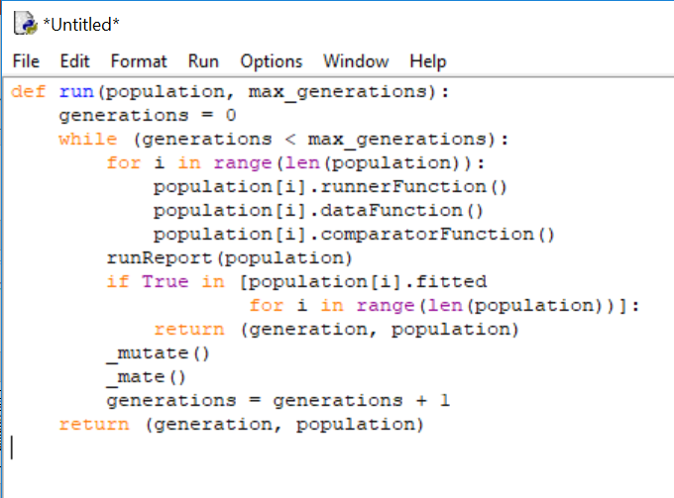
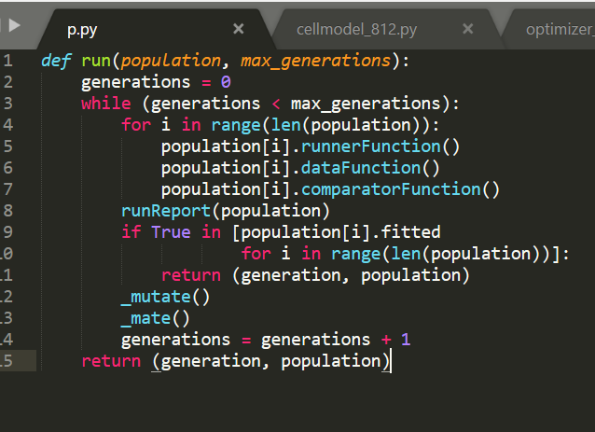
Python Programming Environment
Python IDLE Editor
Sublime Text 3

Slide 50
Hands-On Practice (Part 1)
Time to do some real work……
Using the function to calculate area of circle, implement functions to calculate (a) area of triangle, and (b) area of rectangle.
Now that you have 3 area functions, wrap them into one function; such as,
def area(radius, base, height, type):

Slide 51
Hands-On Practice (Part 1)
Write a function to calculate compound interest,
def compound_interest(principle,
number_of_terms, interest_per_term):
Use your compound interest function to show that you will get more interest if the interest is compounded on a daily basis (0.008%) than on an annual basis (2.92%).
Write a function to calculate mortgage payment – loaned SGD 300 thousand for a flat at 2.6% interest per annum (calculated per month) and pay SGD 1000/month, how long must you pay?

Slide 52
Hands-On Practice (Part 1)
Get the results of mortgage calculation and write the results into a text file.
http://www.pythonforbeginners.com/files/reading-and-writing-files-in-python
http://www.afterhoursprogramming.com/tutorial/Python/Writing-to-Files/
Read the file and display the results on screen.
Why this is important?
Almost every programmer / coder / developer starts by writing codes to read from a storage (such as a file), do some processing, and write into storage (another text file).
We always have to look online to find ways of doing things – look at other people’s codes and improvise.

Slide 53
Hands-On Practice (Part 2)
You are running a chain of Italian restaurants.
You want to survey the “acceptance” of your pastas and coffees.
17 different pasta sauces and 8 different types of coffees.
Customers to rank from 1 to 10 for each item – 1 is most dislike, 10 is favourite; 0 if customer had not tried this item.
You had collected 1000 surveys.

Slide 54
Hands-On Practice (Part 2)
Data
Index 0: ID
Index 1: Age
Index 2: Weight
Index 3: Annual Income
Index 4: Number of Diners
Index 5: Relationship
Index 6: Frequency
Index 7: Average Receipt
Index 8: Pasta - Acciughe
Index 9: Pasta - Aglio e olio
Index 10: Pasta - Alfredo
Index 11: Pasta - Amatricana

Slide 55
Hands-On Practice (Part 2)
Data
Index 12: Pasta - Bolognese
Index 13: Pasta - Burro
Index 14: Pasta - Cacciatore
Index 15: Pasta - Frutti di mare
Index 16: Pasta - Funghi e piselli
Index 17: Pasta - Marinara
Index 18: Pasta - Noci
Index 19: Pasta - Pesto
Index 20: Pasta - Pomidoro
Index 21: Pasta - Romana
Index 22: Pasta – Tartufata
Index 23: Pasta - Umbria

Slide 56
Hands-On Practice (Part 2)
Data
Index 24: Pasta - Vongole
Index 25: Coffee - Espresso
Index 26: Coffee - Long Black
Index 27: Coffee - Flat White
Index 28: Coffee - Latte
Index 29: Coffee - Cuppucino
Index 30: Coffee - Mocha
Index 31: Coffee - Afrogato
Index 32: Coffee – Machiato
What will you be interested to find out?

Slide 57
Hands-On Practice (Part 2)
I had formatted the data file as a Python data structure (diners.py)
Possible Questions:
What is the average receipt?
What is the average age of your diners?
Which item is the least or most ordered?
Which pasta sauce is the most liked?
Which coffee is the most liked?
Think of more questions you can ask…

Slide 58
Hands-On Practice (Part 3)
You are in HR department / Department Heads.
You want to examine why employees leave the company.
You received a set of randomized data of 300 employees.
Data
EmployeeID
Salary (per annum)
Bonus (per annum)
Age (age of employee at joining)
YrService (years in service)
InService (1 = currently in service, 0 = left service)
SatisfactionScore (employee satisfaction score)
PerformanceScore (supervisor’s graded performance score)

Slide 59
Hands-On Practice (Part 3)
The file that you are given is employee_attrition.csv
Read the file into Python and see if you can figure out why employees leave and what are the indicators.
There are some errors in the data – see if you can identify them.
What other data do you need for better analysis?

Slide 60
Summary of Today
What programming and coding are
Several advantages of Python over other programming languages as a first language
Important constructs in Python programming language
Variables, lists, dictionaries
If statement
For loop, While loop
Functions
Python programming environment
Several best practices
Hands-on writing several functions, a case study on survey data and employee attrition each

Slide 61
Supplementary

Slide 62
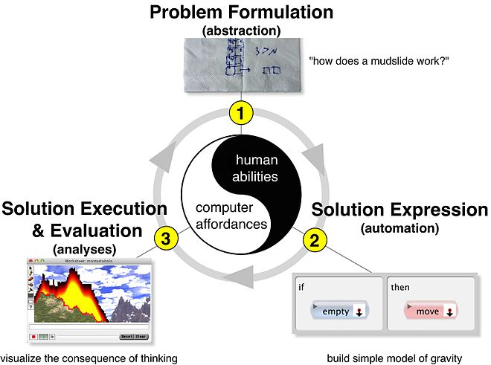
What is Programming
Computational Thinking
https://upload.wikimedia.org/wikipedia/commons/thumb/a/a2/The_Computational_Thinking_Process.jpg/660px-The_Computational_Thinking_Process.jpg

Slide 63
Programming Languages
Programming language is a means to communicate with a computer.
Computer only speaks in binary – ones and zeros.
Humans are generally unable to speak in ones and zeros.
Binary Command | Mnemonics Command | Description
1 1 D D D S S S | MOV d,s | load d with content of s
1 0 0 0 0 s s s | ADD s | add contents of s to A
1 0 0 1 0 s s s | SUB s | sub contents of s from A
1 0 1 0 0 s s s | ANA s | logical AND of s and A to A
1 0 1 1 1 s s s | CMP s | compare s with A, set flags
0 0 d d d 0 0 0 | INR d | increment register d (d<>A)

Slide 64
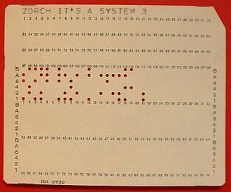
Programming Languages
The earliest computers were programmed in ones and zeros
Punch cards
Switches on panels
Magnetic tapes
First generation programming language (1GL)
Also known as machine language
From 1GL, we progress to make it more human-readable
https://upload.wikimedia.org/wikipedia/commons/thumb/1/19/System_3_punch_card.jpg/330px-System_3_punch_card.jpg

Slide 65
Programming Languages
Comes 2nd generation programming languages (2GL)
Also known as assembly languages
Textual representations of 1GL
Properties
The code can be read and written by a programmer. To run on a computer it must be converted into a machine readable form, a process called assembly.
The language is specific to a particular processor family and environment.
Main applications
Device drivers, microcontrollers, kernels, intensive processes

Slide 66
3rd Generation Programming Languages
More machine independent and programmer friendly
More readable
Does not need to be concerned with registers
Main properties: Structured and procedural
Early examples: Fortran, COBOL
Modern examples: C, BASIC, Pascal
Most programming languages today are 3GLs

Slide 67
What is Python Programming Language
“Python has continued its upward trajectory from last year and jumped two places to the No. 1 slot though the top four—Python, C, Java, and C++—all remain very close in popularity.
Indeed, in Diakopoulos’s analysis of what the underlying metrics have to say about the languages currently in demand by recruiting companies, C comes out ahead of Python by a good margin.” (https://spectrum.ieee.org/computing/software/the-2017-top-programming-languages)

Slide 68
What is Python Programming Language
Pragmatically, one of the more than 3000 programming languages available.
Python is a programming language that is used substantially in scientific community and data analytics.
Python is currently the most popular language for teaching introductory computer science courses at top-ranked U.S. departments (https://cacm.acm.org/blogs/blog-cacm/176450-python-is-now-the-most-popular-introductory-teaching-language-at-top-u-s-universities/fulltext).
Specifically, eight of the top 10 CS departments (80%), and 27 of the top 39 (69%), teach Python in introductory CS0 or CS1 courses.

Slide 69
Who Uses Python Programming Language
https://wiki.python.org/moin/OrganizationsUsingPython
Los Alamos National Laboratory (Theoretical Physics Division): Python to control large-scale physics codes on massively parallel supercomputers, high-end servers, and clusters. Python plays a central role in controlling these simulations, performing data analysis, and visualization.
Johnson Space Center (NASA): Uses Python in its Integrated Planning System as the standard scripting language.

Slide 70
99 Bottles of Beer in C – 3GL
From http://www.99-bottles-of-beer.net/language-c-1954.html
#include <stdio.h>
#include <stdlib.h>
static void song( int bottles )
{
while( (printf("%d bottles of beer on the wall, %d bottles of beer.\n"
"Take one down and pass it around, %d bottle%s of beer on the wall.\n\n",
bottles, bottles, bottles-1, bottles>2? "s":""), bottles > 2) )
while( (--bottles,0) ) {}
while( (puts("1 bottle of beer on the wall, 1 bottle of beer.\n"
"Take one down and pass it around, no more bottles of beer on the wall.\n\n"
"No more bottles of beer on the wall, no more bottles of beer.\n"
"Go to the store and buy some more, 99 bottles of beer on the wall."),0) ) {}
}
int main()
{
while( (song(99), exit(0), 0) ) {}
}

Slide 71
99 Bottles of Beer in C – 3GL (Dedented Version)
From http://www.99-bottles-of-beer.net/language-c-1954.html
#include <stdio.h>
#include <stdlib.h>
static void song( int bottles ){while( (printf("%d bottles of beer on the wall, %d bottles of beer.\n“ "Take one down and pass it around, %d bottle%s of beer on the wall.\n\n", bottles, bottles, bottles-1, bottles>2? "s":""), bottles > 2) ) while( (--bottles,0) ) {} while( (puts("1 bottle of beer on the wall, 1 bottle of beer.\n“ "Take one down and pass it around, no more bottles of beer on the wall.\n\n“ "No more bottles of beer on the wall, no more bottles of beer.\n“ "Go to the store and buy some more, 99 bottles of beer on the wall."),0) ) {}} int main(){while( (song(99), exit(0), 0) ) {}}

Slide 72
99 Bottles of Beer in Python – 3GL
From http://www.99-bottles-of-beer.net/language-python-808.html
for quant in range(99, 0, -1):
if quant > 1:
print quant, "bottles of beer on the wall,", quant, "bottles of beer."
if quant > 2:
suffix = str(quant - 1) + " bottles of beer on the wall."
else:
suffix = "1 bottle of beer on the wall."
elif quant == 1:
print "1 bottle of beer on the wall, 1 bottle of beer."
suffix = "no more beer on the wall!"
print "Take one down, pass it around,", suffix
print "--"

Slide 73
Programming Language vs Scripting Language
Scripting language IS programming language.
Historically, scripting language is a language that supports script writing.
Generally, scripting language do not have a compilation step (compiles to machine language).
The script is generally interpreted and executed line by line (during execution, each line is compiled to machine language).
Hence, scripting language tends to refer to interpreted language.
The actual comparison is compiled language vs interpreted language.
Compiled languages are architecture-specific.
Interpreted languages are architecture-independent.

Slide 74
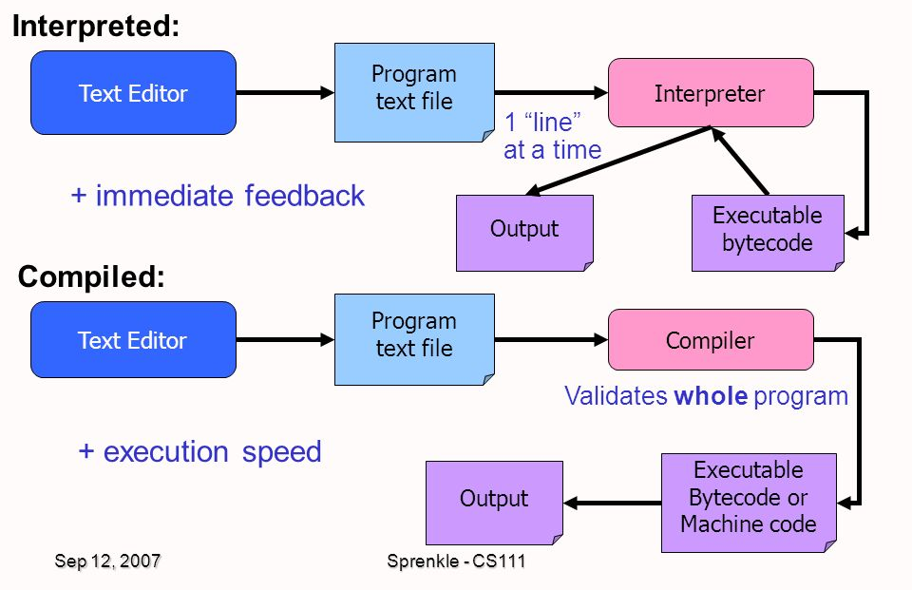
Programming Language vs Scripting Language
http://slideplayer.com/slide/7615243/

Slide 75
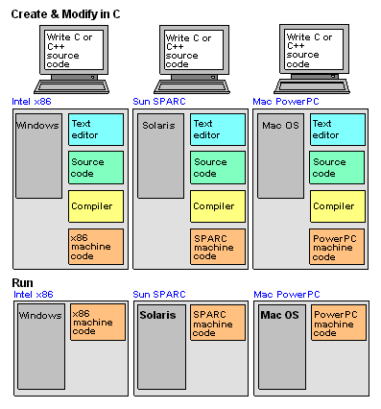
Programming Language vs Scripting Language
Compiled languages are architecture-specific.
Interpreted languages are architecture-independent.
https://www.pcmag.com/encyclopedia_images/BYTECOD1.GIF

Slide 76
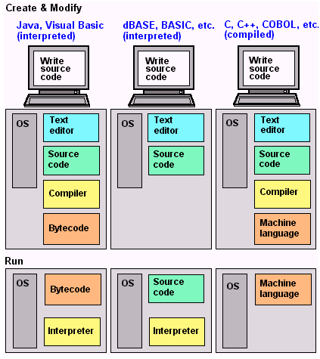
Programming Language vs Scripting Language
Compiled languages are architecture-specific.
Interpreted languages are architecture-independent.
Source code is human readable but bytecodes are closer to assembly (less readable).
https://i.stack.imgur.com/zEt6o.gif

